Slide 1

Deposition: costing, best practice and practical advice
Ray Moore
ray.moore@york.ac.uk

Slide 2

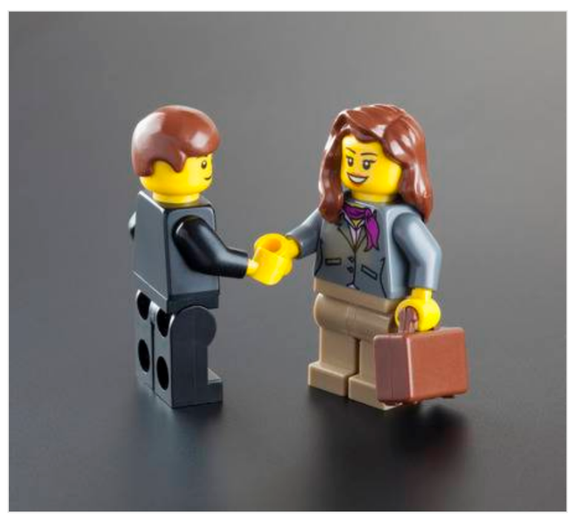
Deposition:
costing, best practice and practical advice
Introduction
A short introduction to the cost of data preservation. (Discussion and questions)
Guidance and best practice on formats and metadata. (Discussion and questions)
Depositing: Using ADS-easy: a practical guide. (Discussion and questions)
The future: the development of OASIS. (Discussion and questions)
Image © https://www.123rf.com/
https://archaeologydataservice.ac.uk/learning/DevonWorkshop2019.xhtml

Slide 3
Deposition:
costing, best practice and practical advice
A short introduction to costing: how to obtain the right costing for your work.

Slide 4

Deposition:
costing, best practice and practical advice
Why bother depositing data?
1. Ensure preservation
2. Provide access
3. Professional recognition
4. Follow professional standards
5. Meet governmental/local authority requirements
6. Meet funding agency requirements
Image © www.digitalbevaring.dk

Slide 5
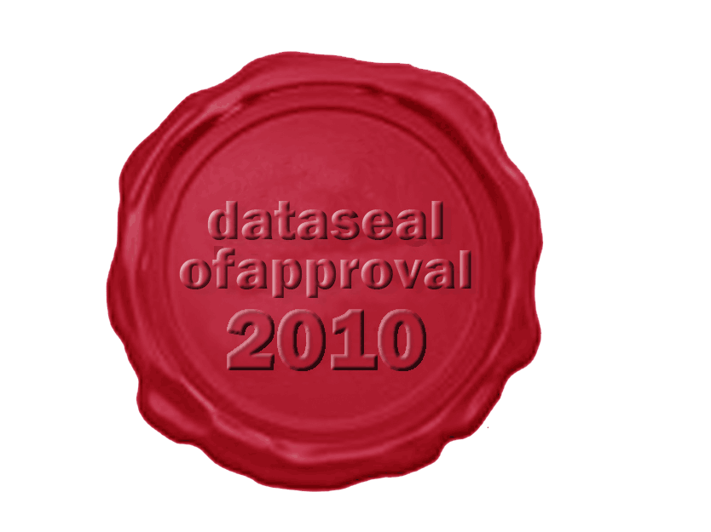
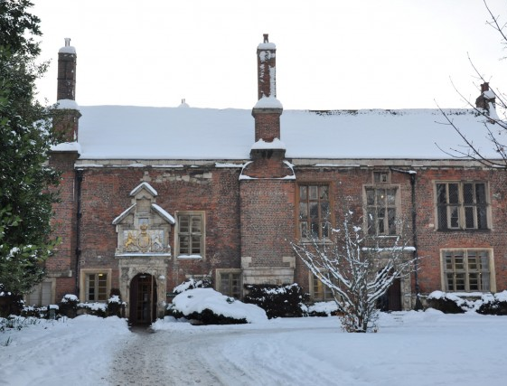


Deposition:
costing, best practice and practical advice
Depositing with the Archaeology Data Service
Set up in 1996
Based within the University of York
Trusted repository with over 20 years dealing with outputs of archaeological projects
Working with the wider digital archiving community, particularly DPC and DCC
Data Seal of Approval 2010, renewed in 2013 when the 2014-15 standard, but also investigating other forms of accreditation
Working closely with the CIFA Archaeological Archives Group, Geophysics Special Interest Group and other agencies and organisations to raise the profile of digital archiving
Creating and setting standards e.g. Guides to Good Practice

Slide 6
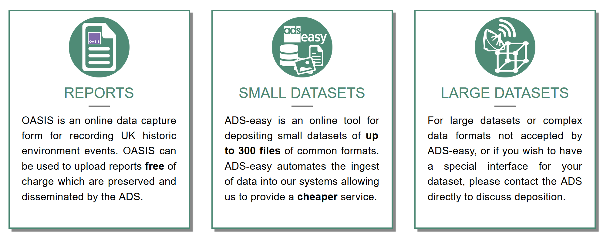
Deposition:
costing, best practice and practical advice
Depositing with the ADS
Aim: To create the flexibility necessary to legislate for differences in workflows, technological experience and infrastructure, and for all budgets in order to facilitate the deposition of data for individuals and organisations. Deposition streams:
  ‘Traditional’ deposition : for all/large datasets
  ADS-easy : for small/medium archives
  OASIS Images : for small image only archives
  OASIS : for fieldwork reports

Slide 7
Deposition:
costing, best practice and practical advice
OASIS
“The overall aim of the OASIS project is to provide an online index to the mass of archaeological grey literature that has been produced as a result of the advent of large-scale developer funded fieldwork and a similar increase in fieldwork undertaken by volunteers”.
Also…
  on-line form used to record event level metadata for fieldwork
  powering online indexes e.g. ArchSearch, Heritage Gateway, etc.
  allowing reports to be shared for validation with HERs & NMRs
  allowing reports to be preserved by the ADS
  allowing reports to be disseminated for wider consumption through the ADS Library
  All this for FREE!

Slide 8
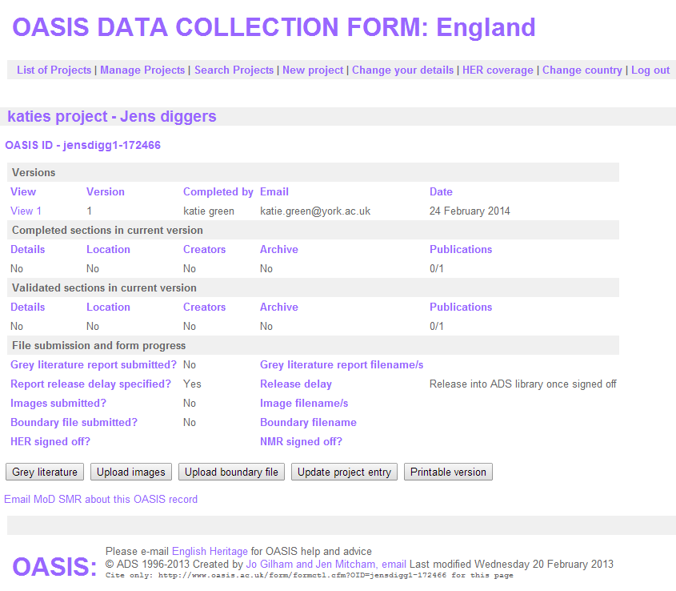
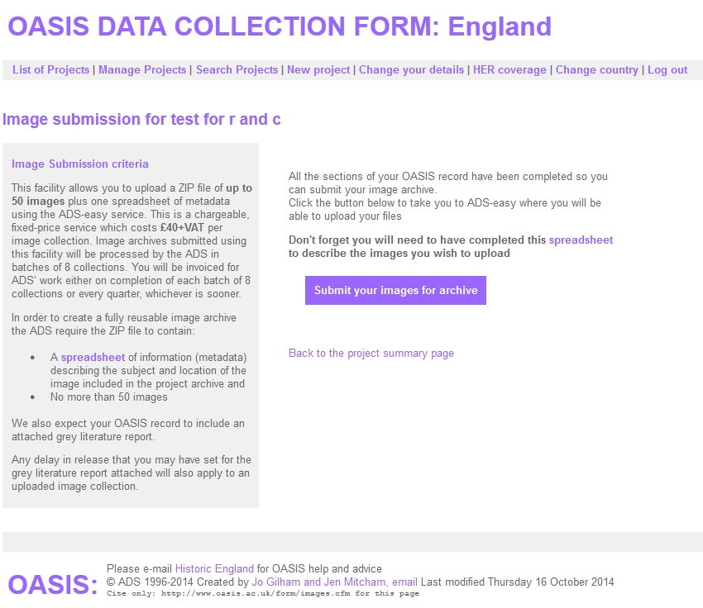
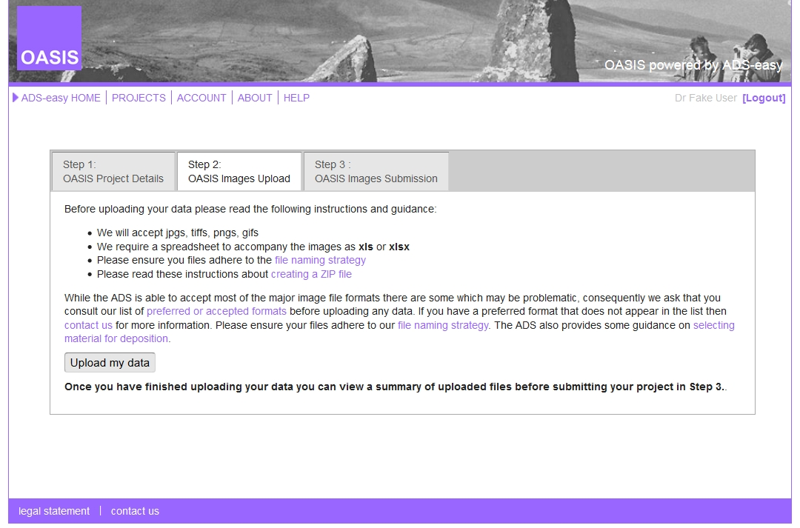
Deposition:
costing, best practice and practical advice
OASIS Images
An additional part of OASIS allowing depositors completing an OASIS form to include a set of images from their project
Uses the ADS-easy system
Allows you to upload up to 150 images and metadata using the ADS-easy service.
Uses the same metadata spreadsheet available through the ADS’ Guidelines for Depositors
A fixed-price service which costs £150+VAT per image collection

Slide 9
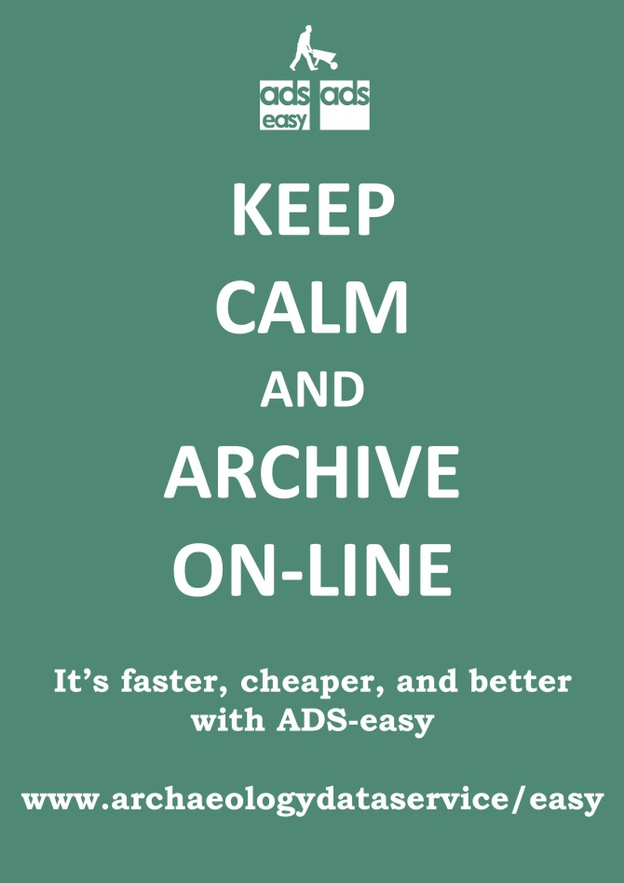
Deposition:
costing, best practice and practical advice
ADS-easy
Used for small/medium archives:
depositions that include certain data types (but not all the data types that the ADS accepts)
  databases
  documents and reports
  Geophysics
  GIS
  maps and plans
  photographs and images
  spreadsheets
files found in the list of accepted formats
files with a maximum size of 100MB
deposits with a maximum of 1000 files
a geophysical survey of less than 50Ha
Take a look: https://archaeologydataservice.ac.uk/easy/

Slide 10

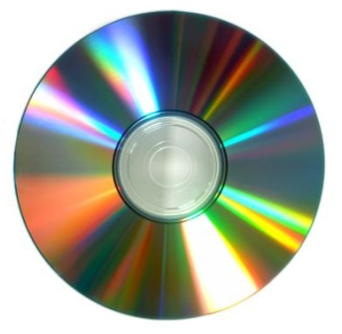

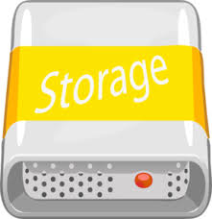



Deposition:
costing, best practice and practical advice
‘Traditional’ deposition
Used for archives of all sizes
typically involves the electronic exchange of data outside of ADS-easy, or the physical movement of data
‘low tech’ approaches are sometimes the most successful
allows the submission of all data types
  including movies, audio, LiDAR, 3D models, etc.
files found in the list of accepted formats
no maximum file size
no maximum deposit size
works well within some workflows, although more expensive

Slide 11




Deposition:
costing, best practice and practical advice
Find the right deposition route for your workflow and the data that you have created
Still unsure… just contact us

Slide 12
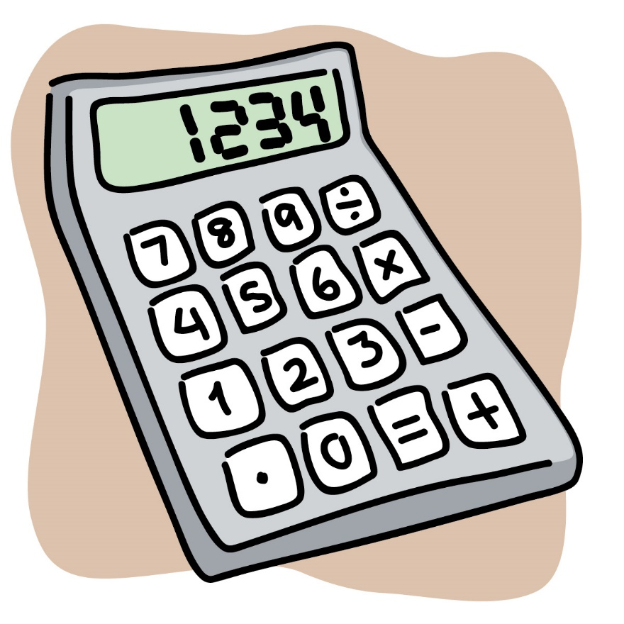
Deposition:
costing, best practice and practical advice
Costing and charging – know the options
OASIS – is a free service
OASIS Images – costs £150 (exc VAT)
ADS-easy – costs vary according to content
  think about selection and retention
  the costing calculator allows you to plan ahead for preservation and create estimates accordingly
  how to use the calculator
  download the estimate
  these costings are not saved
‘Bespoke’ costing – for complex and submissions through ‘traditional’ means
  think about selection and retention
  contact us
  these details are documented and formerly acknowledged

Slide 13
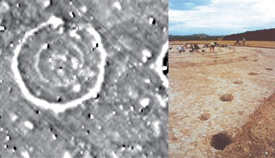
Deposition:
costing, best practice and practical advice
Balancing the cost – how we charge
the basis of an ADS costing is the individual file (except for geophysics)
  this allows granularity for each costing
  the charge for individual files is based on the nature and complexity of the file
    think about format and save some money
    e.g. a specialist report deposited – docx (£2) vs doc (£4) vs pdf (£6)
    e.g. a georectified image – jpg/jpw (£4) vs tif/tifw (£2)
geophysics – charges on an area basis
  experiments with banding but desire for granularity
Image: Historic England 2012 The Geophysical Survey Database

Slide 14
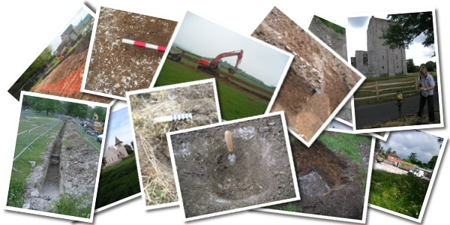
Deposition:
costing, best practice and practical advice
Balancing the cost – how we charge
images – reduction in overall charging with increasing numbers
  OASIS Images
‘start up fee’
  for deposits via ADS-easy (£200)
  for traditional deposits (£500)
    less automation, more manual checking required
storage and refreshment
additional charges for complex interface design
Image © Wessex Archaeology

Slide 15
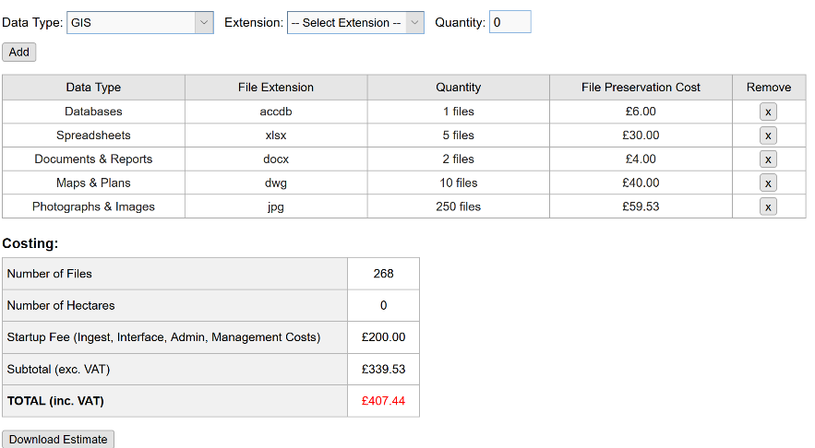
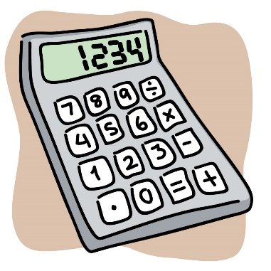
Deposition:
costing, best practice and practical advice
Planning for preservation and passing on costs
know the data you are creating /depositing
plan for preservation from the outset and don’t simply ‘react’ afterwards
think about creating a data management planning
use the resources available to cost for preservation as early as possible in a project
    clear expression of charges
    ADS Costing Calculator
    contact the ADS to get a ‘bespoke’ costing
these tools allow you to factor in charges for deposition of data when tendering for work

Slide 16

Deposition:
costing, best practice and practical advice
Why does preservation seem so expensive?
data preservation is much more than data storage
requires specialist staff with the specific skills
requires a complex technical infrastructure and access to resources
requires qualitative assessment and validation
requires a complex workflow of accession, preservation and dissemination
requires checking and re-checking
requires documentation
requires communication
requires active management of data to maintain data integrity (data is friable) – ‘normalisation’ of data

Slide 17

Deposition:
costing, best practice and practical advice
Questions, comments and discussion about charging and costing?
What do you think about the cost of archiving?
Images: OpenClipArt.org

Slide 18
Deposition:
costing, best practice and practical advice
Guidance and best practice on formats and metadata.

Slide 19


Deposition:
costing, best practice and practical advice
Guidance and best practice (General)
Digital Preservation Coalition
Knowledge Base
  technology watch report
  digital preservation handbook
  preservation tools
  events (webinars and workshops)
‘Bit List’ of digitally endangered species
  crowd-sourcing exercise to discover which digital materials our community thinks are most at risk, as well as those which are relatively safe thanks to digital preservation
Useful resource: https://www.dpconline.org/

Slide 20
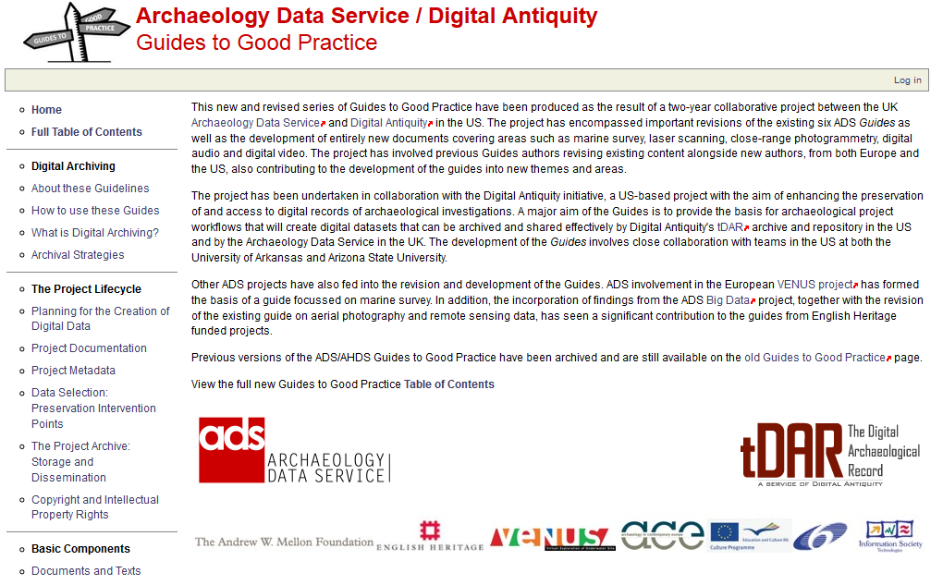
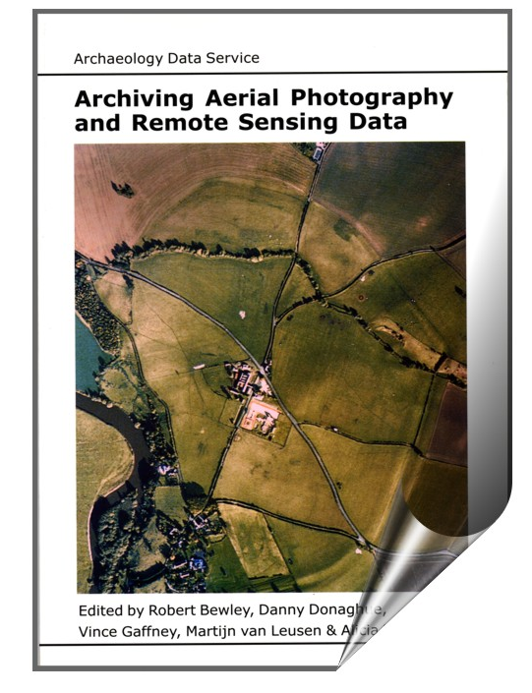
Deposition:
costing, best practice and practical advice
Guidance and best practice on formats and metadata
ADS/Digital Antiquity Guides to Good Practice
Digital Data (general)
Data-type specific
GIS
CAD
3D Models
Geophysics
Aerial Survey
Laser Scanning
Remote Sensing
Photogrammetry
http://guides.archaeologydataservice.ac.uk/

Slide 21
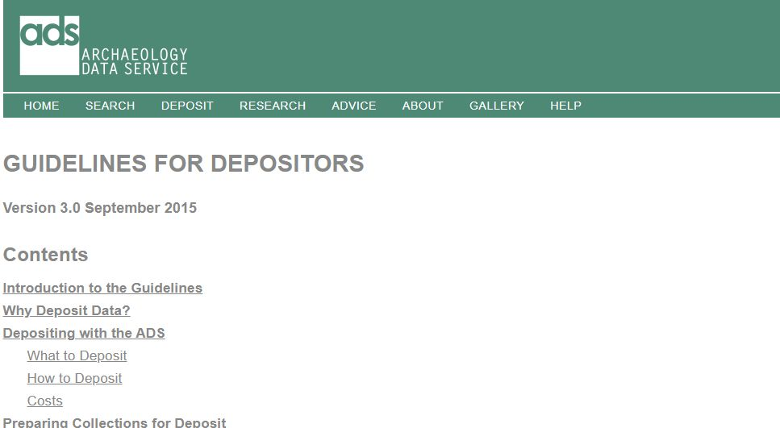

Deposition:
costing, best practice and practical advice
Guidelines for Depositors
Focus on deposition with the ADS, but lots of, but lots of good general advice on data management
Preparing Collections for Deposit
  DMP
  File management (formats, naming, versioning, etc)
Appropriate documentation
Metadata
https://archaeologydataservice.ac.uk/advice/guidelinesForDepositors.xhtml

Slide 22


Deposition:
costing, best practice and practical advice
Image: © Digital Preservation Business Case Toolkit
Data Management Planning
A data management plan (or DMP) is a formal document that outlines how data will be handled during a research project, and also once that project has been completed. The aim of the DMP is to consider the many aspects of data management throughout the data lifecycle; this ensures that all data produced is well-managed in the present, and prepared for preservation in the future.
Thinking about data management allows us to understand how data is created, generated, stored, preserved and used
This isn’t something simply for those undertaking academic research, but for all of us who are actively creating digital data
Useful resource: Digital Curation Centre has a wide variety of resources online to help – e.g. https://dmponline.dcc.ac.uk/)
http://www.dcc.ac.uk/

Slide 23
Deposition:
costing, best practice and practical advice
Data Management Planning
ensure data is accurate, complete, authentic and reliable
flag up where assistance may be necessary
improve efficiency and unnecessary duplication of effort
communicate process to others (enable continuity if staff changes)
save time and resources
improve data security and minimise risk of data loss
think about what data will be created and how
professional reasons
moral obligation
provides a practical starting point to help structure thoughts
ensure data preservation (in short and long term) and allows you to plan for preservation AND reuse

Slide 24

Deposition:
costing, best practice and practical advice
Data Management Planning
Data management is as a first-class endeavour, to which appropriate time and effort should be allocated and suitable funds earmarked
*YAWN* Data management is just SO BORING!
… but I could be sorting out those environmental samples
I just don’t have time to think about that DMP.
Adapted from © Sherry Torkos

Slide 25

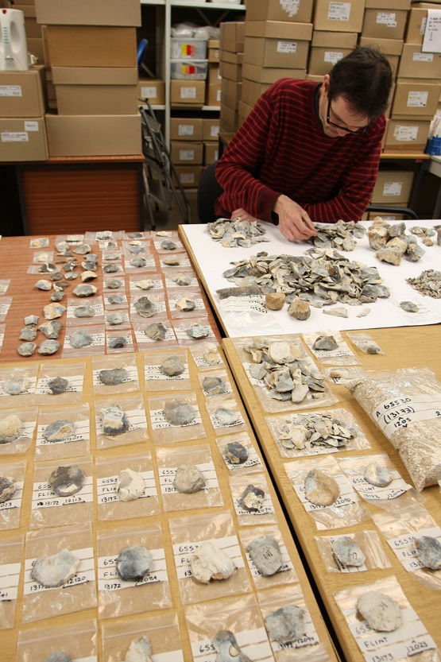
Deposition:
costing, best practice and practical advice
Selection and retention
Toolkit for Selecting Archaeological Archives
The purpose of this Toolkit is to provide a set of useful and flexible resources to assist archaeological practitioners during the creation of project-specific Selection Strategies for the Working Project Archive … it is necessary for a selection strategy to be developed for all archaeological projects. The toolkit can be used to aid and inform that process.
Not simply about physical archives, but include details on digital outcomes as well
Useful resource: http://cifa.heritech.net/selection-toolkit
Flint analysis (© Wessex Archaeology)

Slide 26
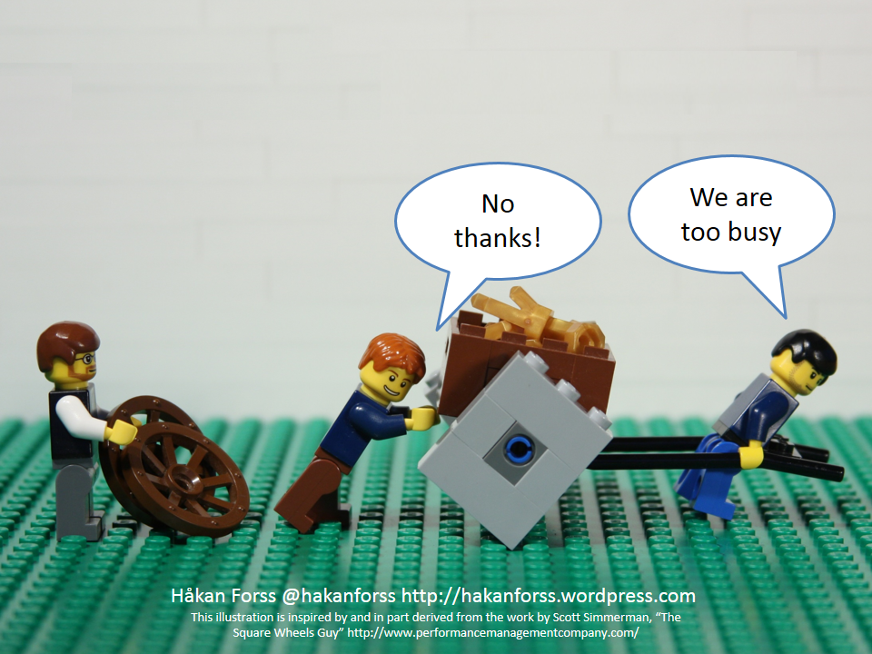
Deposition:
costing, best practice and practical advice
Selection and retention
Useful resources:
DPC’s Digital Preservation Handbook useful section on appraisal
ADS’ Guidance on the selection of material for deposit and archive
getting advice from those setting the requirement to deposit data
Getting data appraisal and selection right is important?
save time and resources
improve efficiency and unnecessary duplication of effort
cost
Hey, if we thought about selection and retention we could make things easier.
Adapted from © Hakan Forss

Slide 27
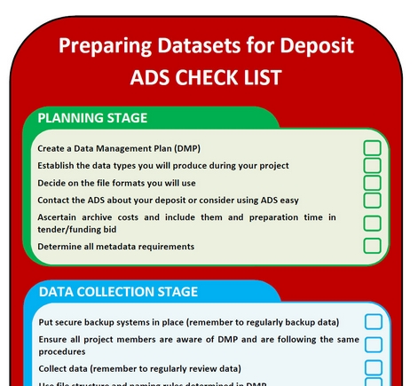
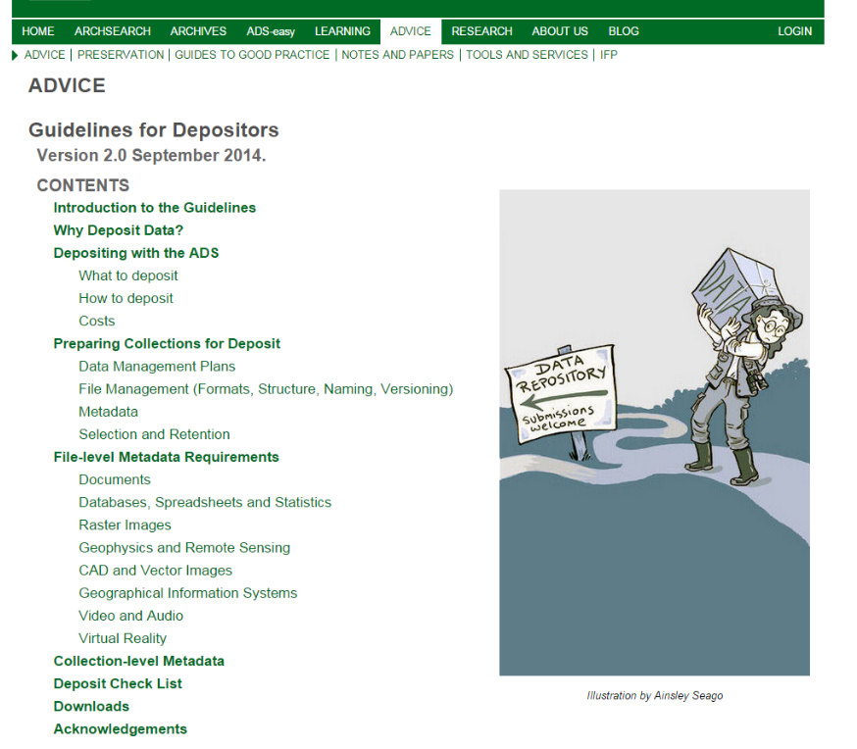
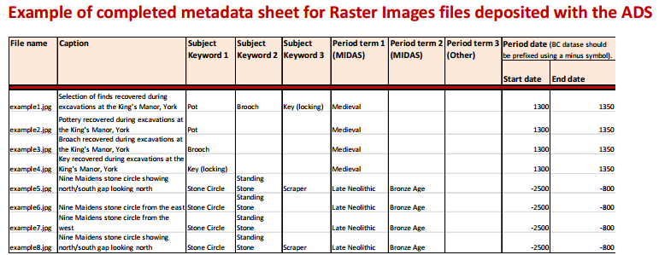
Deposition:
costing, best practice and practical advice
All the information you could ever need
What ever the tool for deposition the Guidelines for Depositors provides all the information you need:
  Depositing with the ADS
  Preparing for deposit
  Collection level metadata
  File level metadata
  Accepted formats
  Deposit checklists
But we also host more general information about digital preservation and archiving
  Archaeology Data Service / Digital Antiquity
  Guides to Good Practice
  Data management and plans
  And much, much, more
20/09/2019
27

Slide 28
Deposition:
costing, best practice and practical advice
Questions, comments and discussion about best practice?
Images: OpenClipArt.org

Slide 30
Deposition:
costing, best practice and practical advice
Depositing: Using ADS-easy: a practical guide.

Slide 31
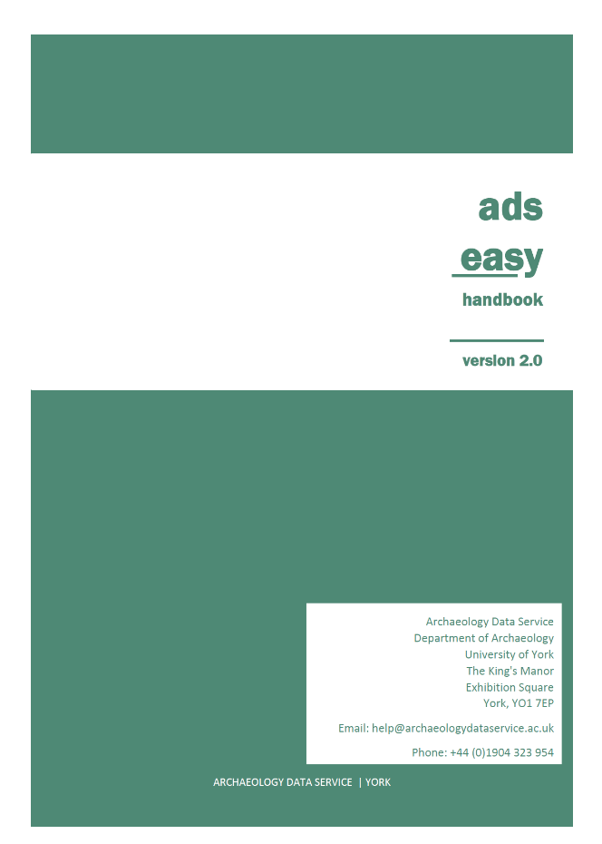
Deposition:
costing, best practice and practical advice
Depositing: Using ADS-easy: a practical guide.
The ADS-easy 2.0 Handbook provides detailed guidance on using ADS-easy and also includes information on OASIS Images
You can download it from the Workshop page on the ADS website: https://archaeologydataservice.ac.uk/learning/DevonWorkshop2019.xhtml
Please let us know if you are having problems using the system via the ADS helpdesk
help@archaeologydataservice.ac.uk, or
https://archaeologydataservice.ac.uk/about/contact.xhtml

Slide 32


Deposition:
costing, best practice and practical advice
Exercise (Therapy session): Split into groups (5-6 people) and discuss your experiences in depositing data, particularly the use of
ADS-easy/OASIS Images.
What works and didn’t work?
What do you like and don’t you like?
Are their any common problems or issues?
Outcome 1: Each group to create lists of good/bad points (20 mins)
Outcome 2: From the lists produced, identify two/three of you ‘best’/’worst’ points (5 mins)
Report best/worst things back to the room
Image: ©Ginger’s Blog
Image: ©PNGImages

Slide 33
Deposition:
costing, best practice and practical advice
Specific questions, comments and discussion about ADS-easy?
Have you got any ‘top tips’?
Images: OpenClipArt.org

Slide 35
Deposition:
costing, best practice and practical advice
The future: the development of OASIS.

Slide 36
Deposition:
costing, best practice and practical advice
The future: redevelopment of OASIS
HERALD (Historic Environment Research Archives, Links and Data) is the name given to the redevelopment of the OASIS…
  rebuilt to accommodate a wider range of workflows for users – continued support for current users, and also support the maritime environment, museums & archives, buildings, geophysics, etc.
  support for wider range of workflows for HER’s - review not validation to expedite the transfer of reports into the public domain
  more up-to-date technology (e.g. semantic interoperability, GIS)
  technical improvements to improve use
  records always open, use of versioning
See HERALD webpage (https://oasis.ac.uk/pages/wiki/HERALD) for more information

Slide 37
Deposition:
costing, best practice and practical advice
The future: redevelopment of OASIS - HIAS
  not happening in isolation
  funding from Historic England is as a distinct Work Package (Collecting + Validating) within their Heritage Information Access Strategy (HIAS) https://historicengland.org.uk/research/support-and-collaboration/heritage-information-access-strategy/
  Additional funding from HES as part of reporting to DES
  Ongoing talks with DoE NI (use of the form) and RCAHMW/Welsh Trusts (sharing metadata)

Slide 38
Deposition:
costing, best practice and practical advice
The future: redevelopment of OASIS - Timescales
Database and Java framework
Pre-Alpha testing in Autumn 2018
Alpha testing Spring 2019
New form available in beta March 2020

Slide 39
Deposition:
costing, best practice and practical advice
The future: redevelopment of OASIS – Where are we?
  a new database is in place
  Java application (i.e. the form in place)
  workflows mapped (i.e. what happens when!)
  mapping to existing heritage thesauri completed
  migration of data from old to new database completed
  basic form in place

Slide 40
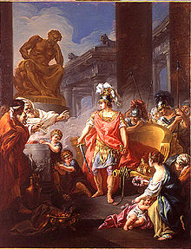
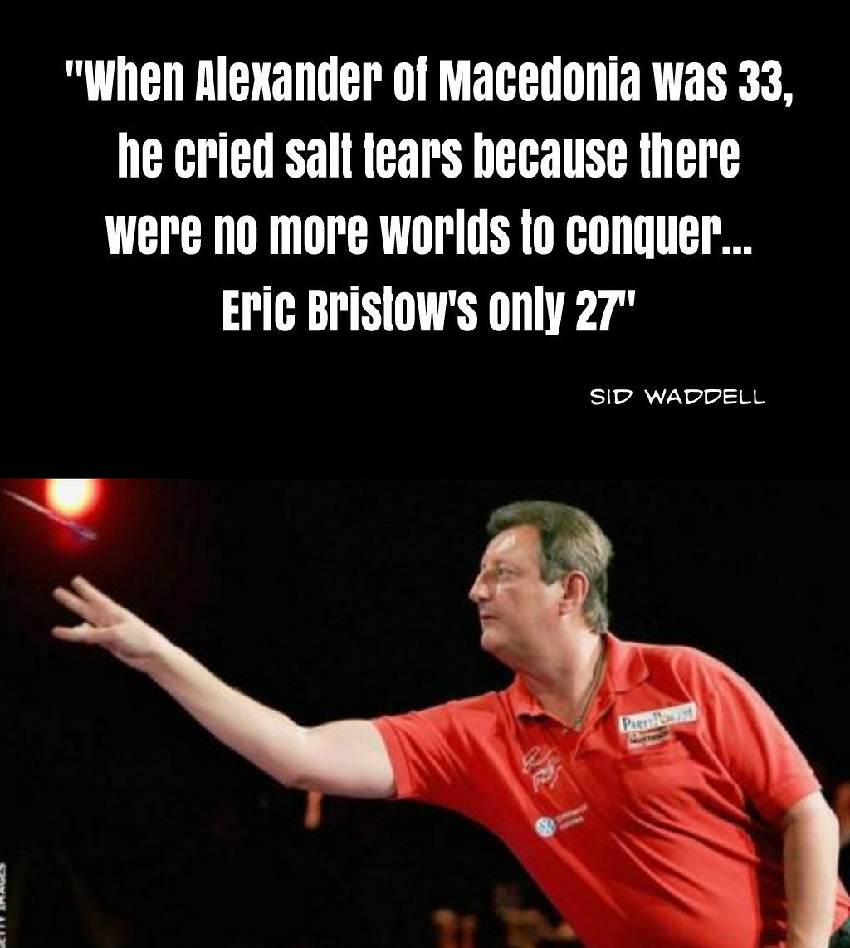
Deposition:
costing, best practice and practical advice
The future: redevelopment of OASIS – Going pretty well?

Slide 41
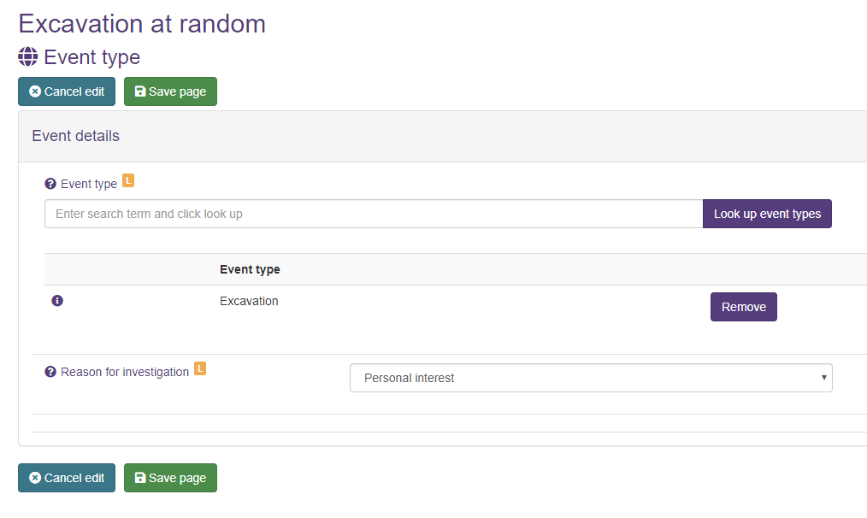
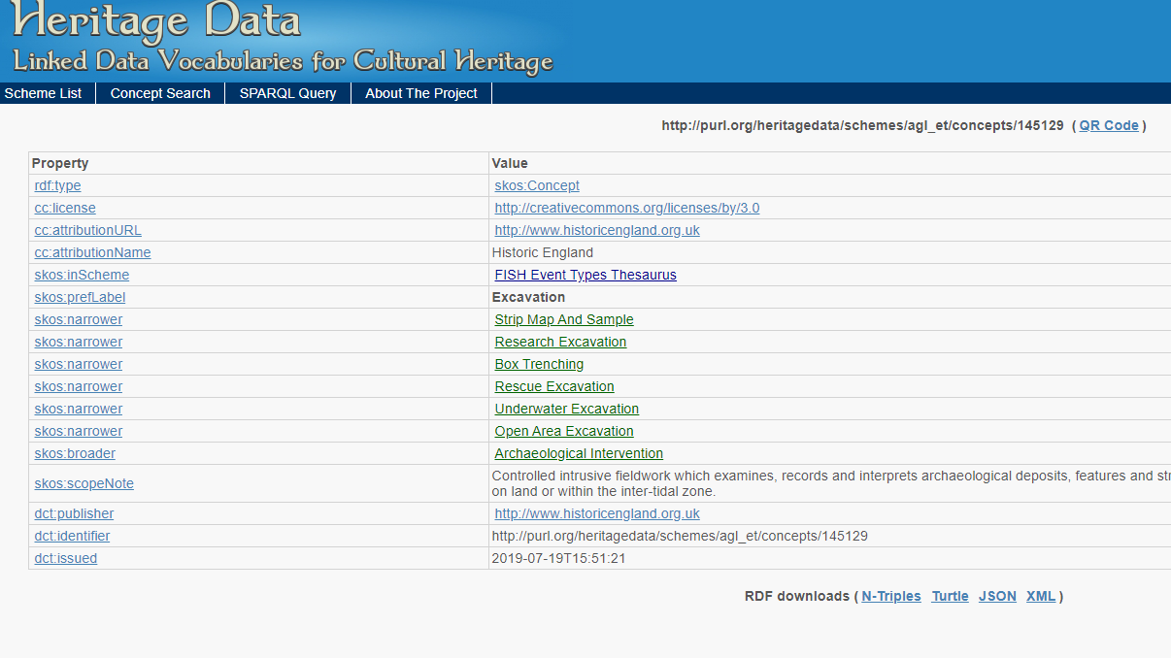
Deposition:
costing, best practice and practical advice
The future: redevelopment of OASIS

Slide 42
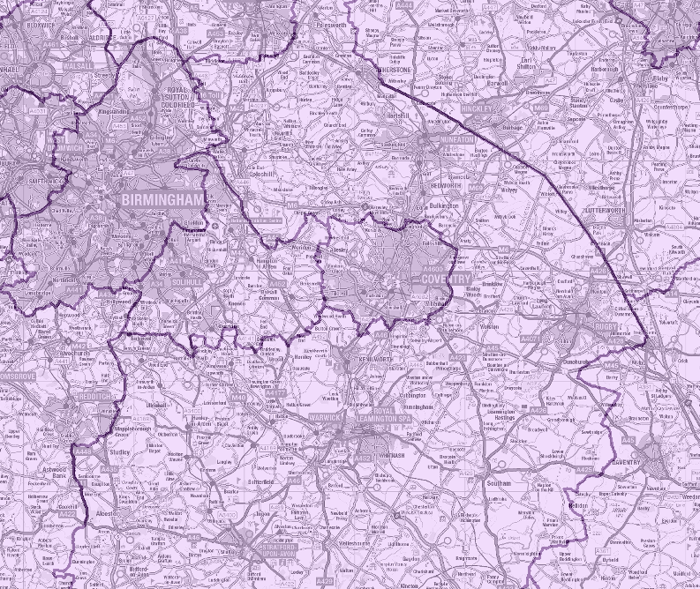
Deposition:
costing, best practice and practical advice
The future: redevelopment of OASIS
  OS admin area
  HER area
  Research Framework
  Museums

Slide 43
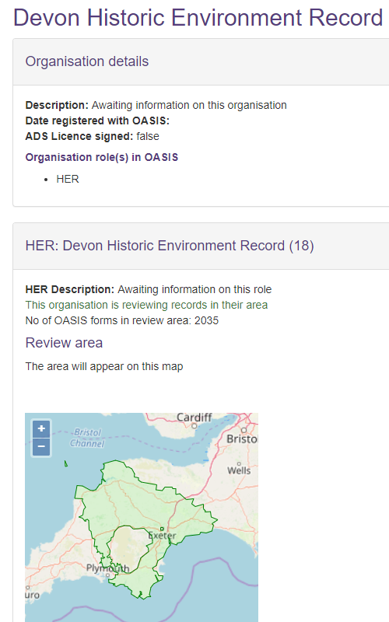
Deposition:
costing, best practice and practical advice
The future: redevelopment of OASIS

Slide 44
Deposition:
costing, best practice and practical advice
The future: redevelopment of OASIS
HERALD web site: http://oasis.ac.uk/pages/wiki/HERALD
Subscribe to the OASIS Blog: http://archaeologydataservice.ac.uk/blog/oasis
Contact HERALD: herald@ads.ac.uk
Twitter: @oasis_data

Slide 45
Deposition:
costing, best practice and practical advice
Any questions?
Images: OpenClipArt.org

Slide 46
Deposition:
costing, best practice and practical advice
Thank You!
Further information
http://archaeologydataservice.ac.uk
http://archaeologydataservice.ac.uk

